Slide 1
Back end Development

Slide 2

Made By
Ahmed Mohamed Abubakr
Electronics engineer IC designer
Full stack web developer
Ambassador at TIEC-IA

Slide 3
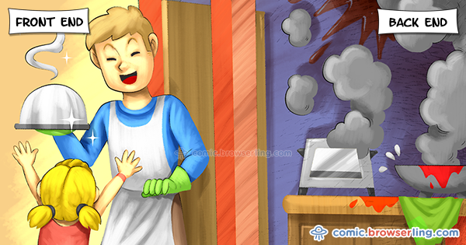

Slide 4
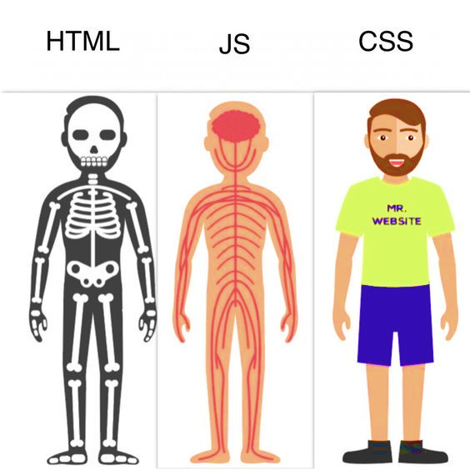

Slide 5


Slide 6
Back-end ?
What is use of back end ?
What I need to run the code ?
Is there any other languages like php ?

Slide 7
PHP History
1994: Created by Rasmis Lesdorf, software engineer (part of Apache Team)
1995: Called Personal Home Page Tool, then released as version 2 with name PHP/FI (Form Interpreter, to analyse SQL queries)
Half 1997: used by 50,000 web sites
October 1998: used by 100,000 websites
End 1999: used by 1,000,000 websites

Slide 8
Alternatives to PHP
Practical extraction and Report Language (Perl)
Active Server Pages (ASP)
Java server pages (JSP)
Ruby
Django

Slide 9
(Good) Topics about PHP
Open-source
Easy to use ( C-like and Perl-like syntax)
Stable and fast
Multiplatform
Many databases support
Many common built-in libraries
Pre-installed in Linux distributions

Slide 10
Lets talk about PHP
Variables / Constants & datatypes
Conditional Statements
Loops
Arrays
Functions

Slide 11
How PHP generates HTML/JS Web pages
Client Browser
1
4
3
PHP module
Apache
2
1: Client from browser send HTTP request (with POST/GET variables)
2: Apache recognizes that a PHP script is requested and sends the request to PHP module
3: PHP interpreter executes PHP script, collects script output and sends it back
4: Apache replies to client using the PHP script output as HTML output

Slide 12
Hello World! (web oriented)
<html>
<head>
<title>My personal Hello World! PHP script</title>
</head>
<body>
<?
echo “Hello World!”;
?>
</html>

Slide 13



Example
Lets create our first task

Slide 14
The End
in the end I hope you understood all I said contact on :
https://www.facebook.com/abobakr143
https://wa.me/201113284597

